Slide 1
SRC 203 - Improving Productivity with SharePoint Search
SharePoint Fest Seattle 2016
Ryan Schouten

Slide 2





Ryan Schouten
Worked with SharePoint for > 9 years
I have experience with SharePoint 2003 – 2016
I have worked with ASP.Net for 15 years
MCPD, MCT, MCSE: SharePoint, MCSA: Office 365
Contact Information
Ryan@sharepointknight.com
@shrpntknight
http://www.sharepointknight.com

Slide 3

Office365 Implementations
Custom SharePoint Development
Responsive Design
Intranet Design/Implementations

Slide 4
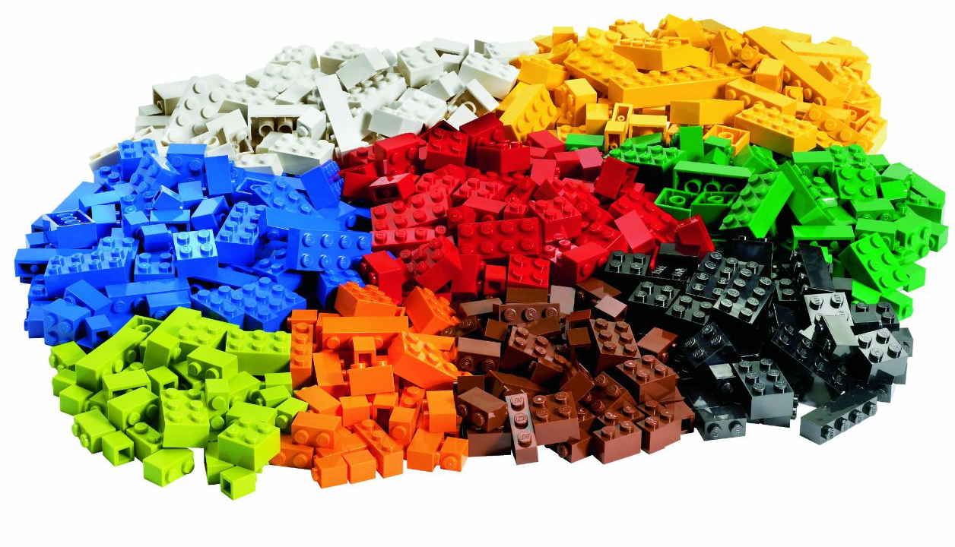

What is Search?
Notes:
Trying to find a lego piece in a pile of Legos.

Slide 5
Metadata
Key to successful SharePoint adoption
Can users find what they are looking for?
Avoid folders
Tag everything
What is it that uniquely identifies this item?
In Lego Terms
Color
Thickness
Shape
Number of Dots
Transparency

Slide 6
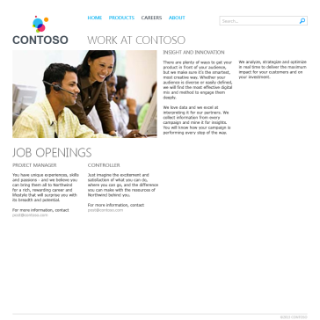
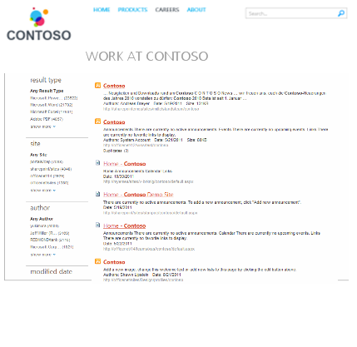

Site Collection A
Site Collection D
Site Collection B
Search Crawl
Search
Content Search Web Part
Site Collection C
List of articles/documents
Recommendations
Popular items

Slide 7
Search as an application tool
It’s fairly obvious but we can search for content
Quick access to a dataset
Could be cached
Could be near real time
Security Trimmed results
Cross Site Content
Easy to work with LARGE sets data

Slide 8
SharePoint 2013 Search
Rewritten to combine SharePoint Enterprise Search and FAST search
New Functionality
Display Templates
Result Types
Query Rules
Query Builder
Site/Site Collection Search Management
Result Sources
Continuous Crawl
Automatic Property Creation
Improved speed and scalability

Slide 9
Display Templates
Determine how the content for search will be rendered
Written in HTML/JavaScript instead of XSL
Best approach is to take an existing template and copy it
Place your display templates in your master page folder

Slide 10
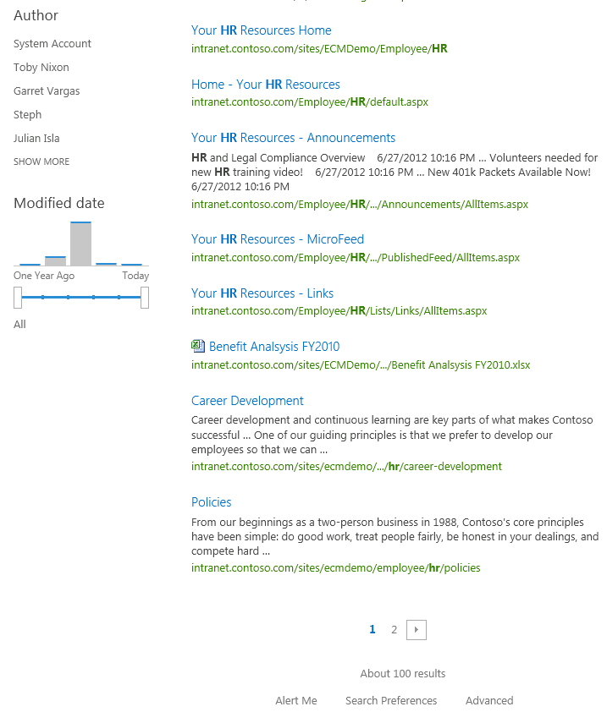
Layers for display templates
Control
Item
Also:
Filter, Group and Hover Panel

Slide 11
Search Options
Search Results Page
Content Search Web Part
Custom Application

Slide 12
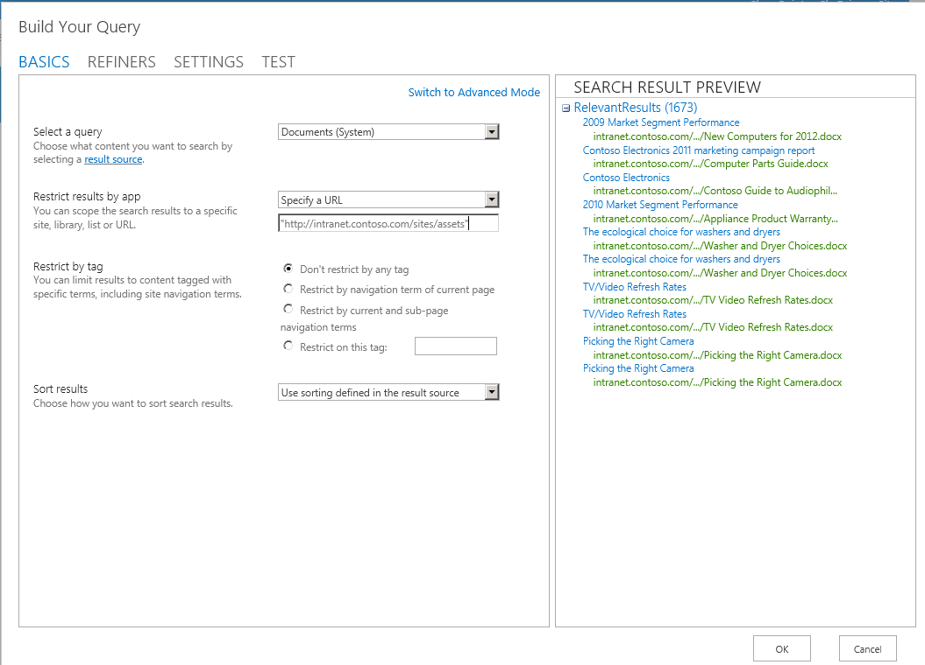
Query Builder: Connecting you to results
Full screen query builder to create/test queries
Fully integrated with result sources and query rules
Create queries
Preview Results
Query variables are substituted at query time

Slide 13
Demo
Notes:
Show the search, query rules, search for orders, display templates

Slide 14

Questions

